Slide 1
GAUSS JORDAN METHOD
NAZMUL KADER CHOWDHURY

Slide 2
Gauss Elimination vs Gauss-Jordan Elimination
Introduction
Both methods are used to solve systems of linear equations.
They use row operations but differ in how far the matrix is simplified.
Aspect | Gauss Elimination | Gauss-Jordan Elimination
Final Matrix Form | Upper triangular form | Reduced row echelon form (RREF)
Pivot Handling | Only zeros below pivots | Zeros both below and above pivots

Slide 3
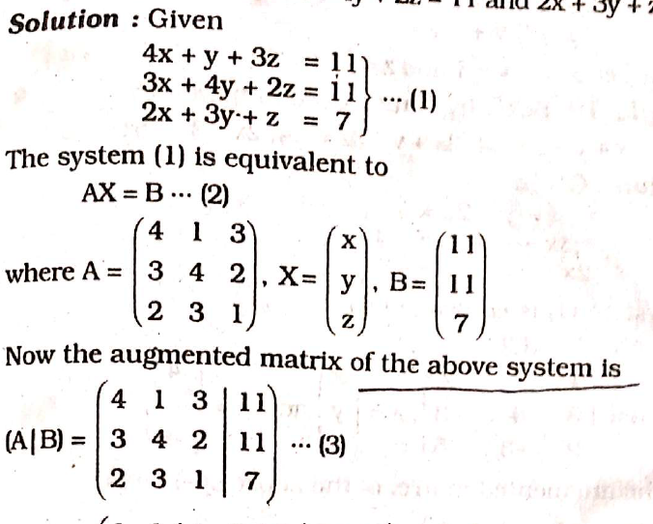
Problem 1
Solve by Gauss-Jordan method
4x+y+3z =11
3x+4y+2z =11
2x +3y+z =7

Slide 4
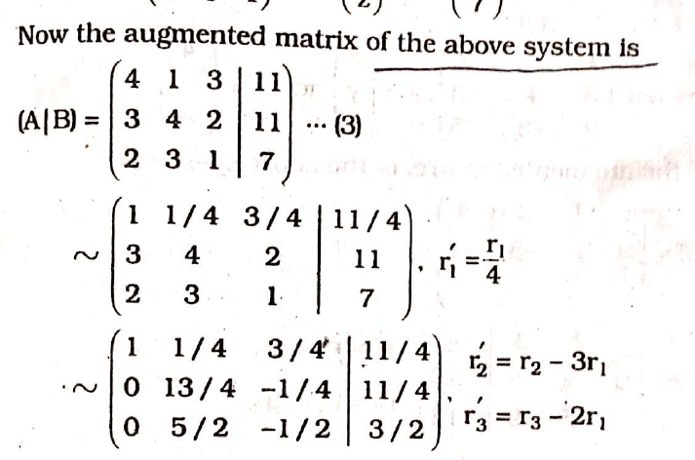

Slide 5
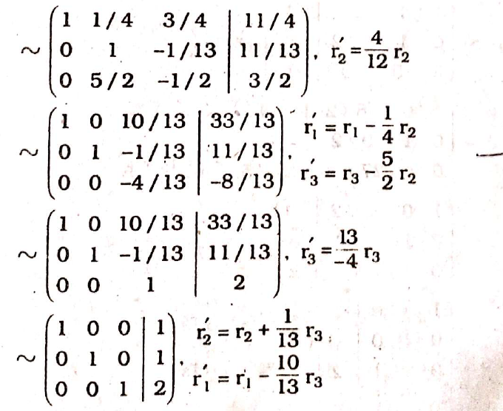

Slide 6
problem 2
Solve by Gauss-Jordan Method
x+y+2z = 4
3x +y-3z = -4
2x -3y -5z =-5

Slide 9
MATH IS THE ONLY PLACE WHERE TRUTH AND BEAUTY MEAN THE SAME THING

